Slide 1
Lead Score Case Study
DEVANSHI SHRIVASTAVA
SONALI MISHRA

Slide 2
PROBLEM STATEMENT
Create a model in such a way that the customers with high lead score have higher conversion chance and low lead score have lower conversion chance. The ballpark of the target lead conversion rate is around 80%.
Also, the model should be able to adjust if the company’s requirement changes in near future.

Slide 3
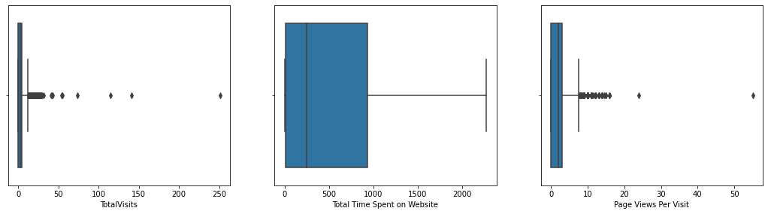
APPROACH OF THE ANALYSIS
-Initially we cleaned the dataset by converting all the binary variables to 0 & 1 and multiple categories to dummy variables.
-We also checked for outliers which can be visualized from the following graphs.
-Outliers are not removed because they are necessary for business requirement

Slide 4
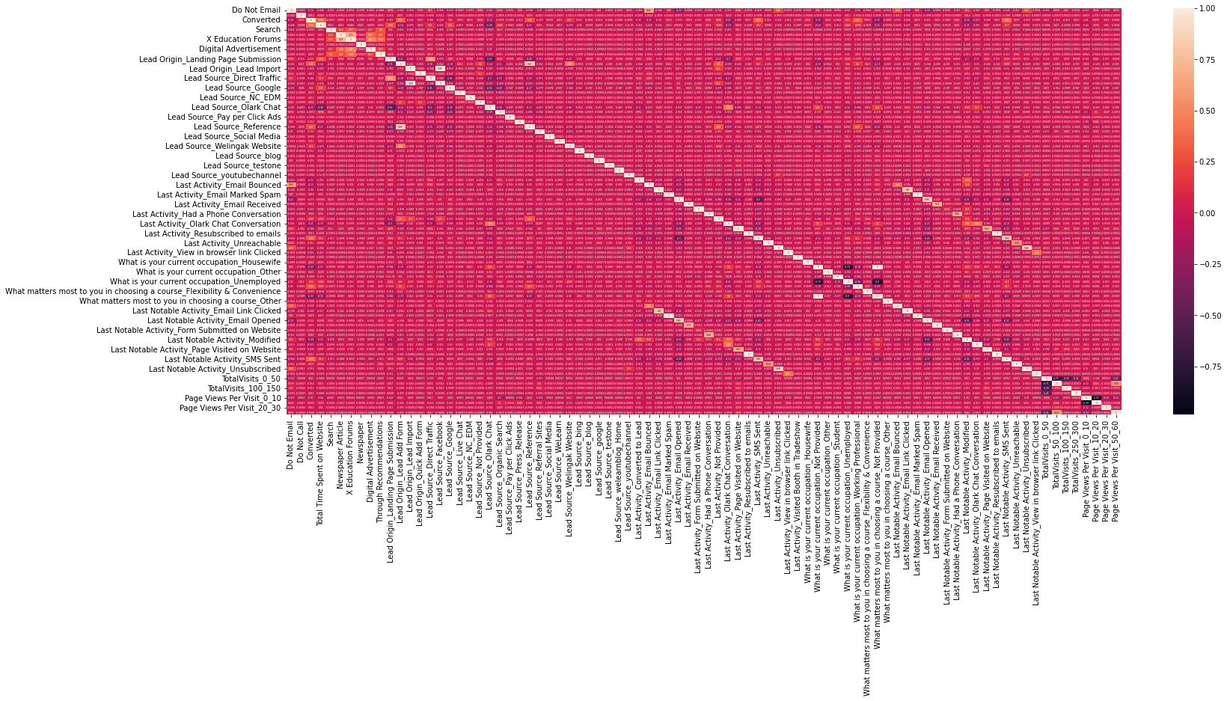
CORRELATION We have plotted a heatmap to find out the highly correlated variables.

Slide 5
MODEL BUILDING - RFE
We built a model with all the features included and found there were many insignificant variables present in our model.
We need to drop them, but we can’t do it one by one as it is time consuming and not an efficient way to do so.
Therefore, we started with RFE method to deduct those insignificant variables. We choose with RFE count 19 and15.
We did two rfe count because we want to find out our final model stability.
We started creating our model with rfe count 19 and went dropping variables one by one until we reach the point where the model is having all significant variables and low VIF values.
Now we evaluated our model by first predicting it. We created new data set with original converted values and the prediction values.

Slide 6
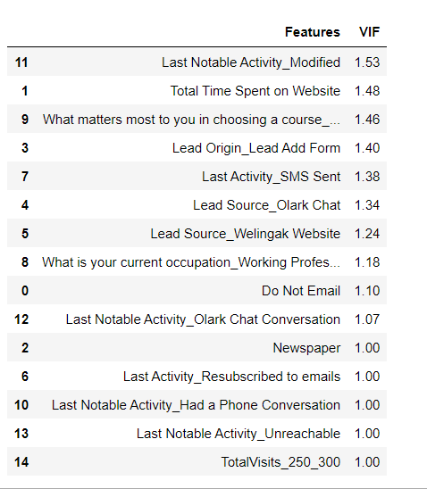
FINAL MODEL VISUALIZATION WITH RFE

Slide 7
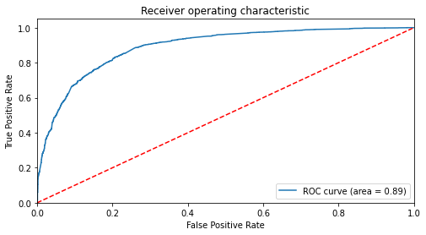
EVALUATING THE MODEL
After building the final
model making prediction
on it(on train set),
We created ROC curve to find the model
stability with auc score(area under the curve)
As we can see from the graph
plotted on the right side,
the area score is
0.89which is a great score
We also see that our graph is
leaning towards the left side of the curve
which means that this is an accurate model.

Slide 8
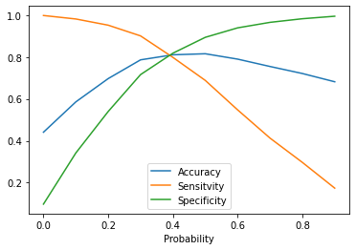
FINDING THE OPTIMAL CUTOFF POINT
We have created range of points
for which we will find the accuracy,
sensitivity and specificity for
each points and analyze which point
to chose for probability cutoff.
We found that on 0.4 point all the
score of accuracy, sensitivity and
specificity are in a close range which
is the ideal point to select and hence it was selected.
To verify our answer we plotted
this in a graph –line plot which is on the
right side and we stand corrected that
the meeting point is close to 0.4 and hence we
choose 0.4 as our optimal probability cutoff.

Slide 9
PRECISION AND RECALL
We used this cutoff point to create a new column in our final dataset for
predicting the outcomes.
After this we did another type of evaluation which is by checking Precision and Recall.
Hence, we evaluated the precision and recall for this model and found the score.
as 0.74 for precision and 0.79 for recall.
Now, recall our business objective -the recall percentage I will consider more
valuable because it is okay if our precision is little low which means less hot lead.
customers but we don't want to left out any hot leads which
are willing to get converted hence our focus on this will be more on Recall than Precision.
We get more relevant results as many as hot lead customers from our model.

Slide 10
RFE 1 VS RFE 2
We want to choose our final
model for test dataset
prediction and in order
to do that we plotted ROC
curve for the RFE 2 model
and compared these two graphs
Attached graph plotted
for the RFE 2 on the right
which has the same aucie0.89.

Slide 11
PREDICTION ON TEST DATA
Before predicting on test set, we need to standardize the test set and need to have exact same columns present in our final train dataset.
After doing the above step, we started predicting the test set and the new predictions values were saved in new data frame.
After this we did model evaluation i.e. finding the accuracy, precision and recall.
The accuracy score we found was 0.81, precision 0.74 and recall 0.79
approximately.
This shows that our test prediction is having accuracy , precision and recall score
in an acceptable range.
This also shows that our model is stable with good accuracy and recall/sensitivity.
Lead score is created on test dataset to identify hot leads –high the lead score higher the chance of converted, low the lead score lower the chance of getting converted.

Slide 12
CONCLUSION
Insights-
The Accuracy, Precision and Recall/Sensitivity are showing promising scores in test set which is as expected after looking the same in train set evaluation steps. Means the recall is having high score value than precision which is acceptable for business needs.
In business terms, this model has an ability to adjust with the company’s
requirements in coming future.
This concludes that the model is in stable state.
Important variables from the model:
Last Notable Activity_Had a PhoneConversation
Lead Origin_Lead Add Forman
What is your current occupation_WorkingProfessional

